Slide 1
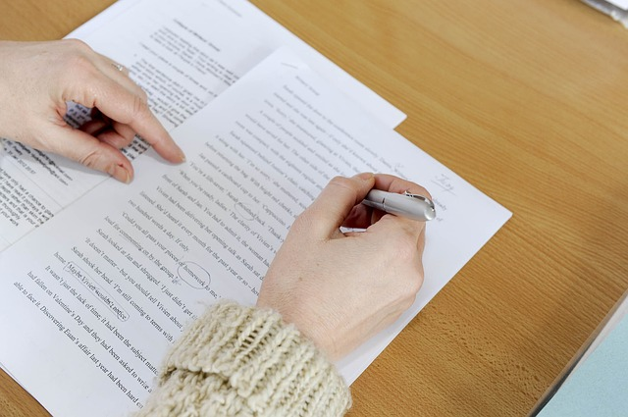
Citing Your Resources
Why and How to Cite the Resources
You Consult in Preparing a
Report, Research Paper or a Project
Photo: http://pixabay.com/en/creative-writing-editing-library-108545/Creative Commons CC0
http://www.infotopia.info/newsletter.html

Slide 2
Why Do I Have to Cite Resources?
Academic Honesty—You want to give credit for ideas that are not your own! (You do not want to be accused of plagiarism!)
It’s Required—Schools and colleges require you to cite your references
Better Grades!—You will probably get a better grade if you show that you have consulted a variety of resources, rather than just a few
Image: https://openclipart.org/detail/191069/happy-girl--by-scout-191069 Creative Commons CC0

Slide 3
What is a Citation?
A citation includes important information about the books, encyclopedias, web sites, videos, databases, magazines, etc. that you used in preparing your report and usually includes:
Author (if given)
Title
Publisher, etc.
Date
It is usually included in an alphabetical list at the end of the paper on a page called Works Cited.
Image: http://pixabay.com/en/help-button-red-emergency-support-153094/
Public Domain CC0

Slide 4
Avoid Plagiarism!
So, let’s see….I can just copy these pages and I would be finished with my report…..right?
Photo: https://openclipart.org/detail/28635/readerboy-by-jantonalcor Public Domain CC0

Slide 5
Avoid Plagiarism!
No, that is plagiarism. Plagiarism means stealing someone’s ideas or words and using them as your own.
Image: https://openclipart.org/detail/17631/cartoon-owl-sitting-on-a-book-by-lemmling
Creative Commons CC0

Slide 6
Avoid Plagiarism!
Did you know that teachers have access to plagiarism checkers that can determine if your paper is in
your own words?
Not only could you fail the assignment, in college, students can be expelled for plagiarism!
Image: https://openclipart.org/detail/17631/cartoon-owl-sitting-on-a-book-by-lemmling
Creative Commons CC0

Slide 7
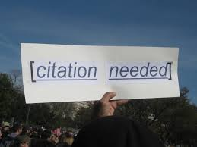
Writing a Report, Research Paper, or a Project
When you are doing research, you may paraphrase the information you find, or you may add quotations.
When you use someone’s ideas or quotations, you must cite (credit) the resources that you use.
Photo: By futureatlas.com (originally posted to Flickr as "Citation needed")
[CC-BY-2.0 (http://creativecommons.org/licenses/by/2.0)], via Wikimedia Commons

Slide 8
How to Paraphrase
Read widely about your topic from a variety of reliable resources and then put the information in your own words. In other words, summarize the information.
Be sure to take notes from all the resources before you start writing your paper.
Be sure to include all your resources on the Works Cited page.
Image: http://pixabay.com/en/eyes-school-student-teacher-34619/ Creative Commons CC0

Slide 9
How to Use Parenthetical References
If you discover an important idea or some data that you want to use, be sure to include a parenthetical reference next to it in your paper.
Source with an author--(Smith 24)--Author and page number
Source without an author--(History Today 26)--Title and page number
Internet resource with an author--(Smith)--Author only--no page number
Internet resource without an author--(history.com)--only the name of the web site
Example: There have been seven cycles of glacial advance and retreat in the last 650,000 years. (NASA.gov)

Slide 10
Paraphrasing Examples
Original--“Chimps are generally fruit and plant eaters, but they also consume insects, eggs, and meat, including carrion. They have a tremendously varied diet that includes hundreds of known foods.” “"Chimpanzee." National Geographic Animals. National Geographic, n.d. Web. 27 June 2014. <http://animals.nationalgeographic.com/animals/mammals/chimpanzee/>.
Poor Example--Chimps are generally fruit and vegetable eaters, but they also consume bugs, eggs, and meat, including dead animals. They have a very varied diet that includes hundreds of foods. (Note: This person just substituted a few words in the original and didn’t include a reference to a citation.)
Good Example--Chimpanzees eat a wide variety of foods, much like humans. Although their diet is usually vegetarian, consisting of fruits and plants, it may also include proteins such as insects, eggs, or meat. (National Geographic Animals) (Note: This was rewritten in the author’s own words and includes a parenthetical reference to the citation.)
Image: https://openclipart.org/detail/7657/boy-question-??-by-romanov
Public Domain

Slide 11
How to Use Quotations
If you find an important quotation that you want to include in your paper, be sure to use quotation marks and cite the author and page number of the resource in parentheses next to the quotation.
Be sure to include the complete citation on the Works Cited page also.
Image: https://openclipart.org/detail/191354/good-grade--by-scout-191354
Public Domain CC0

Slide 12
How to Use Quotations
Here is an example of a quotation from an article on a web site that needs to be cited with a parenthetical reference:
“Climate scientists are concerned that the increase in carbon dioxide is causing global warming, and this may cause a rise in sea level, changing precipitation patters, droughts, heat waves, and more.” (Kennedy)
Here is the citation for the Works Cited page:
Kennedy, Caitlyn. "Climate Change: Atmospheric Carbon Dioxide." http://www.climate.gov, 30 Aug. 2009. Web. 26 June 2014. <http://www.climate.gov/news-features/understanding-climate/climate-change-atmospheric-carbon-dioxide>.
Image: http://pixabay.com/en/happy-sun-rays-shine-smile-smiley-47083/
Public Domain CC0

Slide 13
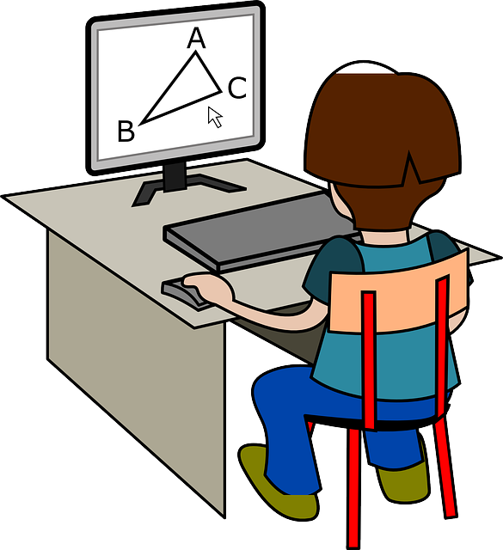
Remember….
Be sure to keep list of all the resources that you use as you take notes. For quotations or important ideas or data, record the page numbers too.
Once you write your paper, be sure to give credit for the information, quotations, and ideas on the Works Cited page.
Image: http://pixabay.com/en/geometry-mathematics-155757/ Creative Commons CC0

Slide 14
Works Cited
At the end of the paper, include a correctly formatted list of all resources consulted to write the paper.
Be sure to include all online resources, books, magazines, newspapers, videos, etc. that you reviewed.
Photo: http://en.wikipedia.org/wiki/Book#mediaviewer/File:Urval_av_de_bocker_som_har_vunnit_Nordiska_radets_litteraturpris_under_de_50_ar_som_priset_funnits_%283%29.jpg
CC-BY-2.5-dk

Slide 15
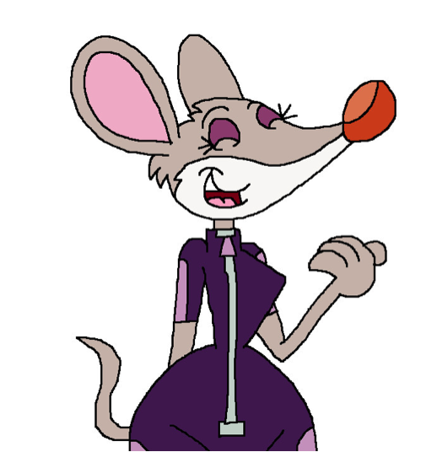
Which Style?
Find out if your school or teacher requires a certain Citation Style…
MLA
APA
Chicago
Photo: http://hunterxcolleen.deviantart.com/art/Thea-giggling-in-her-wetsuit-449920925

Slide 16
Works Cited
Determine if your resource is a…..
Book (basic, dictionary, encyclopedia, etc.)
Periodical (magazine, journal, or newspaper)
Multimedia (cartoon, art, advertisement, map, sound recording, video, etc.)
Communication (speech, personal interview, radio or TV program, etc.)
Online article or web site
Photo: http://www.epa.gov/win/winnews/images05/0510keyboard.gif
Public Domain

Slide 17
Online Citation Creators
The easiest way to create a Works Cited page is to use a reliable online citation creator.
You can enter all the information required, produce the citation, and copy it into your Works Cited page.
Photo: http://www.clipartbest.com/smiley-with-heart

Slide 18
Recommended Citation Creators
KnightCite from the Hekman Library at Calvin College in Grand Rapids, MI
http://www.calvin.edu/library/knightcite/index.php
Free and available for MLA, APA, and Chicago Styles
You can register for free and save your citations, or you can create your citations and copy and paste into your own documents as you go….
Image: https://openclipart.org/detail/67117/mr-happy-by-shokunin
Public Domain CC0

Slide 19
Recommended Citation Creators
Son of Citation Machine
http://www.citationmachine.net/
Free and available for APA, MLA, Chicago or Turabian
You create your citations and copy and paste into your own documents as you go….
Image: https://openclipart.org/detail/25187/architetto----blocco-notes-by-anonymous-25187
Public Domain CC0

Slide 20
Recommended Citation Creators
EasyBib
http://www.easybib.com/
Free and available for MLA only
You can create your citations and copy and paste into your own documents as you go….
Imagehttp://www.clipartsfree.net/clipart/7350-happy-pencil-clipart.html
Public Domain CC0

Slide 21
Additional Recommended Resources
Purdue University Online Writing Lab (OWL)—How to conduct research, use research, and how to create citations (This is an excellent resource!)
https://owl.english.purdue.edu/owl/section/
Internet Public Library Research and Writing Tips
http://www.ipl.org/div/aplus/
Image: https://openclipart.org/detail/1036/look-it-up-by-johnny_automatic
Public Domain CC0

Slide 22
Bibliography
"Chimpanzee." National Geographic Animals. National Geographic, n.d. Web. 27 June 2014. <http://animals.nationalgeographic.com/animals/mammals/chimpanzee/>.
Easy Bib. N.p., n.d. Web. 27 June 2014. <http://www.easybib.com/>.
KnightCite. Hekman Library at Calvin College, n.d. Web. 28 June 2014. <http://www.calvin.edu/library/knightcite/>.
"Links to Citation Resources." Infotopia.info. Ed. Dr. Michael Bell and Carole Bell. Infotopia, n.d. Web. 27 June 2014. <http://www.infotopia.info/citations.html>.
Ray, Mark. "Cr@p I have to cite my sources!." portalsso.vansd.org/portal/page/portal/Media_Pages/./MLA7.ppt. Vancouver Public Schools, 2009. Web. 27 June 2014.
Research and Citation Resources. The Online Writing Lab (OWL) at Purdue University, n.d. Web. 27 June 2014. <https://owl.english.purdue.edu/owl/section/2/>.
Schwartz, Kathryn L. A+ Research and Writing for High School and College Students. Internet Public Library, n.d. Web. 27 June 2014. <http://www.ipl.org/div/aplus/>.
Warlick, David. Son of Citation Machine. Landmark for Schools, 29 Oct. 2000. Web. 28 June 2014. <http://www.citationmachine.net/>.

Slide 23
Notes
All images used in this presentation are from Google Advanced Search and are classified as “free to use, share, or modify, even commercially.” Citations are included on each slide.
The music was created by the author on GarageBand.
This presentation was created by Carole Bell and is licensed as: Attribution-NonCommercial-NoDerivatives 4.0 International (CC BY-NC-ND 4.0)
Contact the author for more information at bell@infotopia.info
http://www.infotopia.info
http://www.infotopianewsletter.blogspot.com/p/presentations.html
Image: https://openclipart.org/detail/169346/colored-student-girl-by-cliparteles Public Domain CC0

